Slide 1

Project 1: PokeDex
Amina Guled

Slide 2
Tech Stack: technologies used
Scala Version 2.11.12
SBT Version 1.6.0
Apache Spark–Hive Version 3.1.2
MySQL Version 8.0.27
Hadoop 3.0
VS CODE

Slide 3
Pokedex: Project Scope
Stores all Pokemon In a Partitioned and bucketed table
User Login System with account update functionality and CLI.
Uses Two user Types With special Admin Functionality
ALLOWS FOR INTERESTING POKEMON FACTS AND QUICK STAT INFORMATION

Slide 4
Query Questions
1.) What pokemon gives most power for least effort?
2.) What are some of the latest pokemon?
3.) What are the strongest fairy pokemon?
4.) How many pokemon currently exist and what genration are we in?
5.) What are the Top 10 Smallest and Top 10 Largest Pokemon(Ordered by Height Descending)?
6.) Search all stats for pokemon with specific ability or for a specific pokemon?

Slide 5

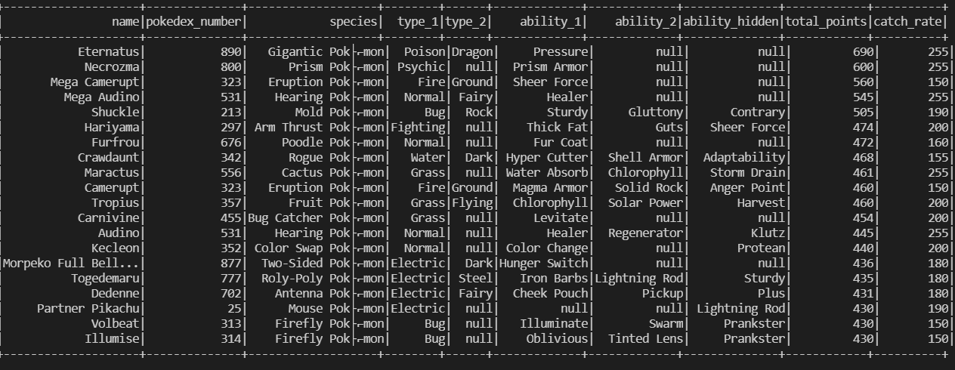
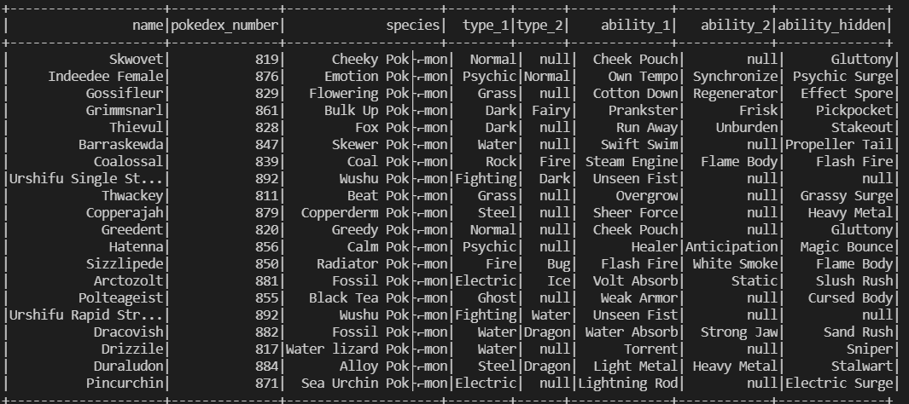
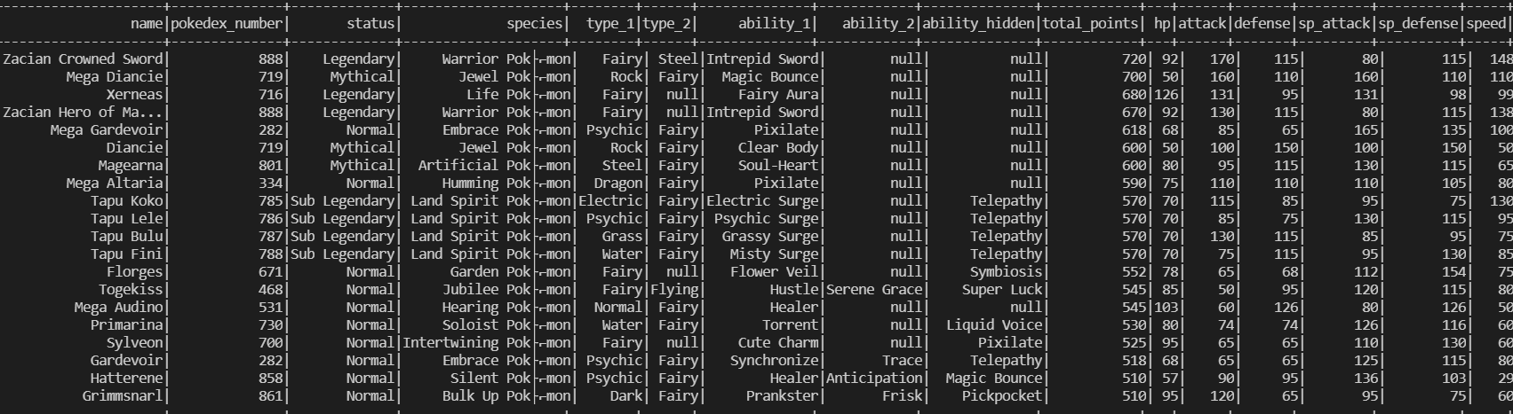
Results From Queries
1.)
2.)
3.)

Slide 6
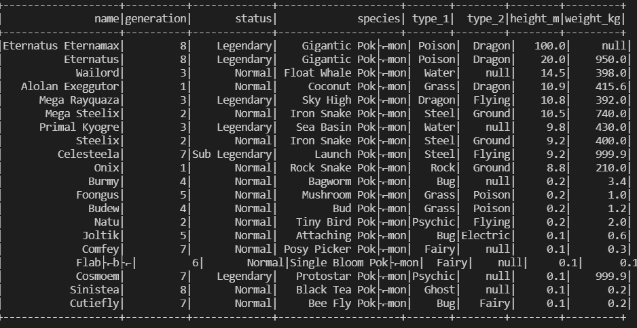

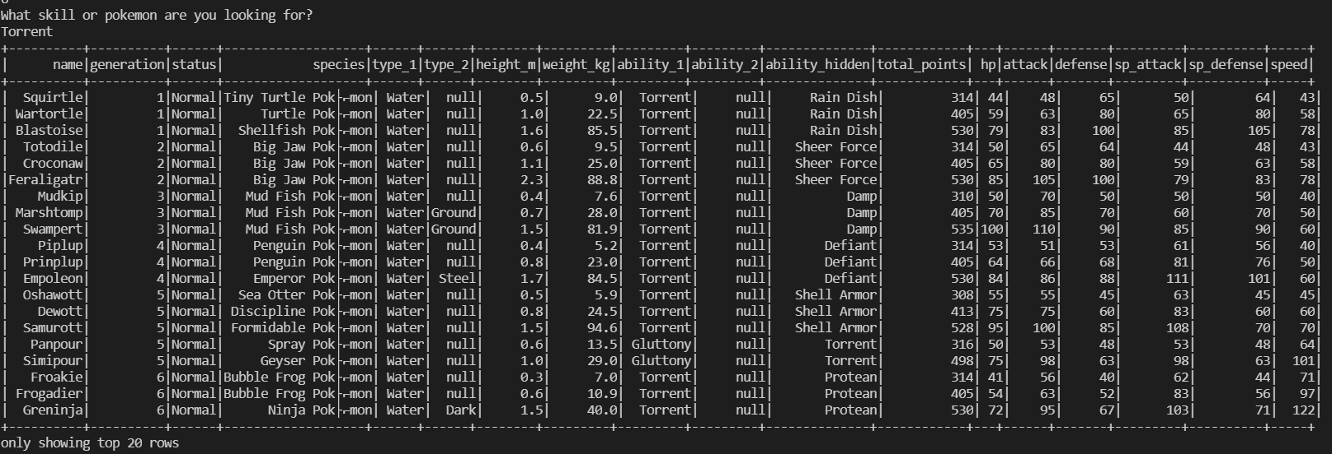
5.)
4.)
6.)

Slide 7

Demo Time:
GITHUB: https://github.com/ahguled.git

Slide 8
Thank YOU!
Questions ???

